Slide 1
CSX4109 / ITX4109
ANDROID APPLICATION DEVELOPMENT

Slide 2
NAVIGATION

Slide 3
COMPONENT
NavController - Navigating between Destinations
NavGraph - Destination Mapping
NavHost - Composable Displaying Current Destination

Slide 4
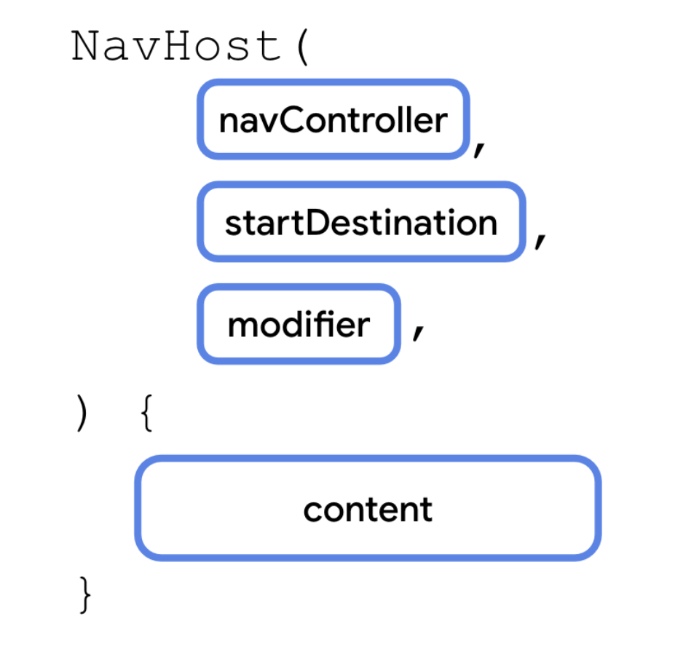
NAVHOST

Slide 5
NAVHOST
NavHost(
navController = navController,
startDestination = CupcakeScreen.Start.name,
modifier = Modifier.padding(innerPadding)
) {
// CONTENT
}

Slide 6
NAVHOST CONTENT

Slide 7
ROUTING
NavHost(
...
) {
composable(route = “Page1”) {
StartOrderScreen(
…
)
}
}

Slide 8
ROUTING DEFINITION
A String for a Destination
Same as URL in Website
Destination is a Single Composable

Slide 9
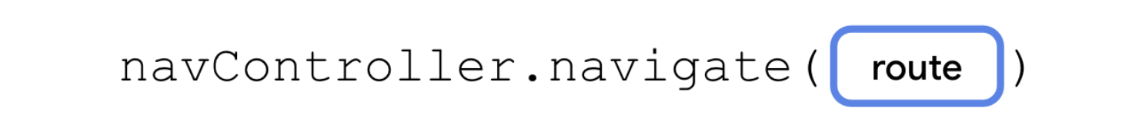
ROUTE NAVIGATION

Slide 10
PUT TOGETHER
NavHost(...) {
composable(route = CupcakeScreen.Start.name) {
StartOrderScreen(
onNextClicked = { navController.navigate(CupcakeScreen.Flavor.name) }
)
}
composable(route = CupcakeScreen.Next.name) { ... }
composable(route = CupcakeScreen.Flavor.name) { ... }
}

Slide 11
BELOVED DEPENDENCY AGAIN
implementation(“androidx.navigation:navigation-compose:2.7.4")

Slide 12
EXCERCISE 1
Create an Android application to allow the user to enter the name. Once the user clicks the “OK” button, it navigates to another screen with a welcoming message as shown in the designs
JOHN
HELLO JOHN
OK
NEXT

Slide 13
BACK STACK

Slide 14
BACK STACK
Held by NavController
Contains Already Visited Destinations
Last-In-First-Out (LIFO)

Slide 15
BEHAVIOR
First Destination - Startup Screen Pushed to Back Stack
Navigation - Destination Pushed to the Top
Popping - Pop the Top from the Stack

Slide 16
POP BACK
navController.popBackStack(route, inclusive)
Default - Pop Current Destination (Pressing Back)
Route - Navigate Back to Route
Inclusive - If Route Should be Popped Too

Slide 17
POP UP
navController.navigate(route_destination, navOptions = navOptions {
popUpTo(route)
// Pop all routes in the back stack until the given route is found
})

Slide 18
ARGUMENT PASSING
composable(route = "details/{number}",
arguments = listOf(navArgument("number") { type = NavType.IntType })
) { navBackStackEntry ->
val number = navBackStackEntry.arguments?.getInt(“number") ?: 0
ShowNumberScreen(number)
}

Slide 19
EXCERCISE 2
Create an Android application to predict the nationality and its probability of a name given by the user
HELLO JOHN
Nationality: NG
Probability: 0.076
JOHN
Other Guess
AE: 0.038
PREDICT
TZ: 0.036
US: 0.029

Slide 20
NAME PREDICTION API
https://api.nationalize.io/?name=john

Slide 21

ASSIGNMENT
Create an Android application to show the characters in Rick and Morty based on the following design
https://rickandmortyapi.com/api/character
File Name Format: {{COURSE}}_{{SECTION}}_Assignment_1_{{STUDENT_CODE}}
Example: CSX4109_541_Assignment_1_5510138

Slide 22
Character List
Character Detail

Slide 23
THANK YOU

